Slide 1





Ngororero, 05/09/2025

Slide 2

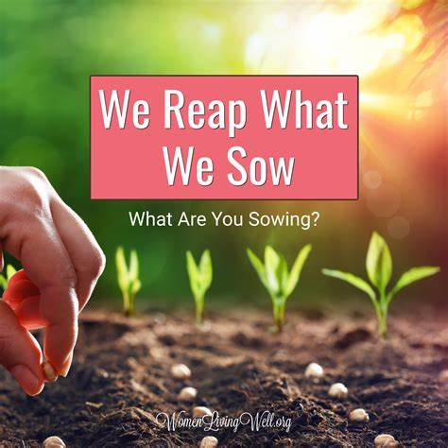

1. SEASON 2026A READINESS
Season preparation meeting done at different levels
Joint effort needed for readiness of season 2026A preparation prior to boost productivity.
The effort that we use today will define our future productivity

Slide 3
Farmer registration in smart nkunganire (SNS)
NO | SECTORS | Target | Registered | % | Pending farmers
1 | NGORORERO | 7,642 | 5,987 | 78.34 | 345
2 | NDARO | 4,214 | 4,809 | 114.12 | 121
3 | KAVUMU | 5,592 | 4,639 | 82.96 | 113
4 | KAGEYO | 4,400 | 5,197 | 118.11 | 76
5 | SOVU | 5,393 | 5,427 | 100.63 | 52
6 | MUHANDA | 4,255 | 4,551 | 106.96 | 45
7 | MUHORORO | 3,654 | 3,278 | 89.71 | 42
8 | GATUMBA | 3,786 | 3,736 | 98.68 | 29
9 | MATYAZO | 4,375 | 3,899 | 89.12 | 25
10 | HINDIRO | 5,837 | 4,038 | 69.18 | 23
11 | KABAYA | 4,962 | 4,361 | 87.89 | 22
12 | BWIRA | 3,849 | 3,504 | 91.04 | 18
13 | NYANGE | 2,199 | 2,022 | 91.95 | 14
TOTAL DISTRICT |  | 60,158 | 55,448 | 92.17 | 925
SNS: Non registered farmers in SNS which will delay the ordering of inputs

Slide 4
2. SUMMARY ON SEASON 2026 A PROGRESS
N0 | Crop | Target (ha) | Prepared area (ha) | Planted area | % of prepared area | % of planted area
1 | MAIZE | 4,118 | 2,888 |  | 70.1 | 0
2 | BEANS | 9,540 | 6,300 |  | 66.0 | 0
3 | IRISH P | 4,031 | 2,041 | 235 | 50.6 | 5.83
4 | CASSAVA | 3,095 | 1,990 |  | 64.3 | 0
5 | SOYBEAN | 572 | 333 | 143 | 58 | 25
6 | WHEAT | 300 | 0 |  | 0 | 0
Total |  | 21,656 | 13,552 |  | 63 | 0
Land preparation is about 63%: There is a need to raise up awareness or campaign for season preparation. “Let us cultivate every piece of land so that no one is left behindto ensure food security.”

Slide 5
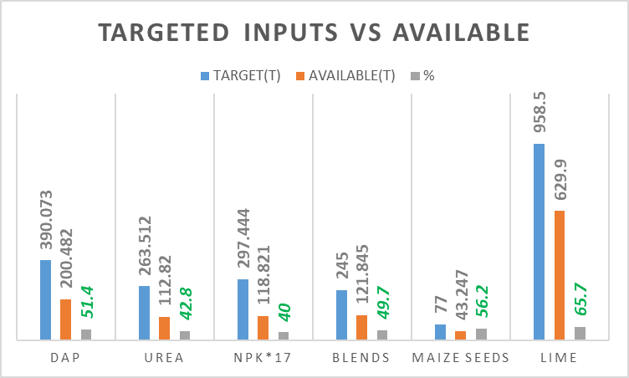
3. CURRENT SITUATION OF AGRICULTURAL INPUTS
Challenges:
Shortage and stock out of inputs in some agrodealers’ shops

Slide 6
4. FOBASI PROGRAM IN 2026A
AGRONOMIC KPLs
MANAGERIALS KPLs
Gutegura ubutaka no gutera imyaka ku gihe
Abahinzi bakoresheje inyongeramusaruro (OM, Seeds, chemical fertilizers and lime )
Kurwanya indwara n'ibyonyi
Kurwanya isuri, gutera ibiti
Gushinganisha ibihingwa
Gufata neza umusaruro no kugira gahunda kuwugeza kw'isoko
Site ifite ibipimo ndangahantu
Kugira umukozi ushinzwe iyamamazabuhinzi kuri site
Kugaragaza imiterere y'ikigamijwe n'intego
Kugira amategeko y'umwihariko y'akoperative
Kugira gahunda irambuye(Business plan) no kubika amakuru
Kuba site icungwa nk'umurima umwe

Slide 7
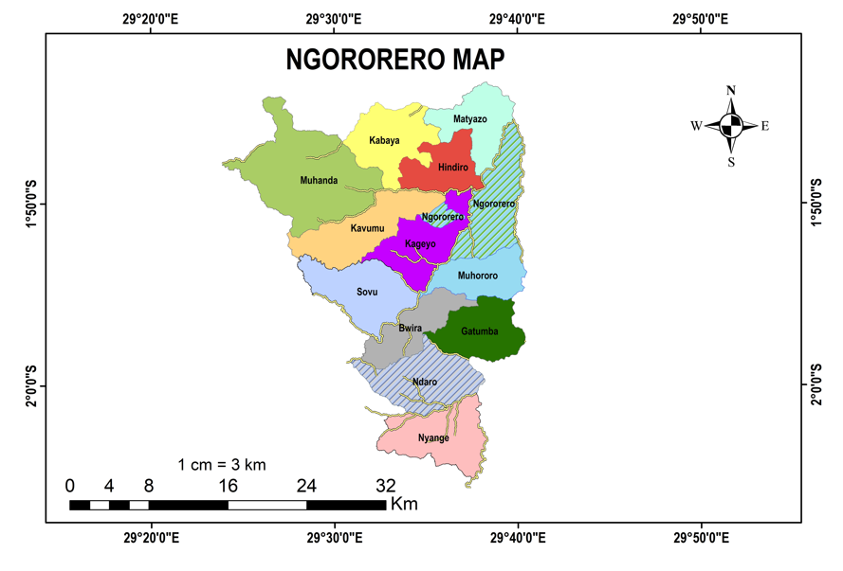
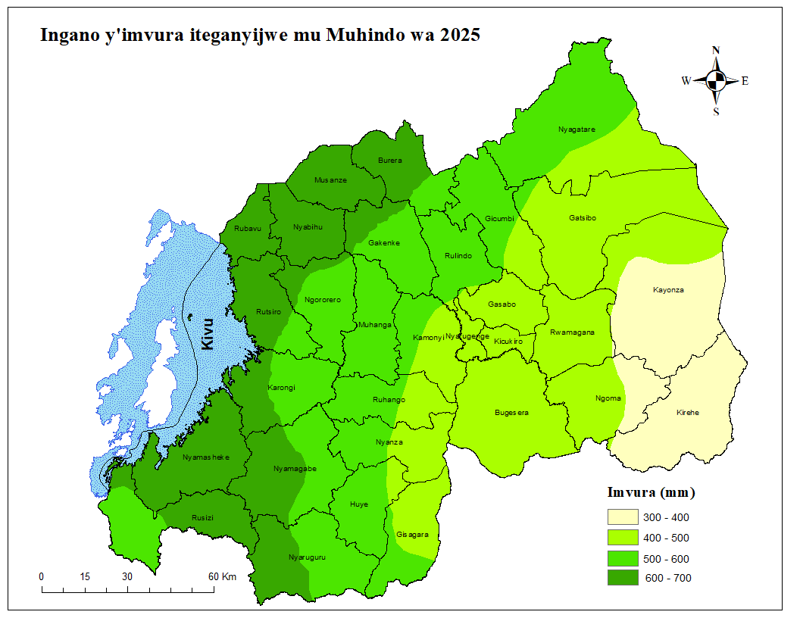
5. Meteo Rwanda forecast
Mu majyaruguru y’Akarere ka Ngororero:
Imvura: 600-700mm
Izatangira kuwa 08-15 Nzeri 2025
Izacika kuwa 22-29 Ukuboza 2025
Igice gisigaye cy’Akarere ka Ngororero:
Imvura 500-600mm
Izatangira kuwa 08-15 Nzeri 2025
Izacika 15-22 Ukuboza 2025

Slide 8
Season 2026A calendar
July -August 2025
October-November2025
September-August 2025
December 2025
Farmer registration, Mobilization, site preparation, inputs distribution
Pests and diseases protection, season monitoring
2025 |  |  |  | 2025
Harvesting time and post harvest handling facilities
Planting and adoption of GAPs

Slide 9
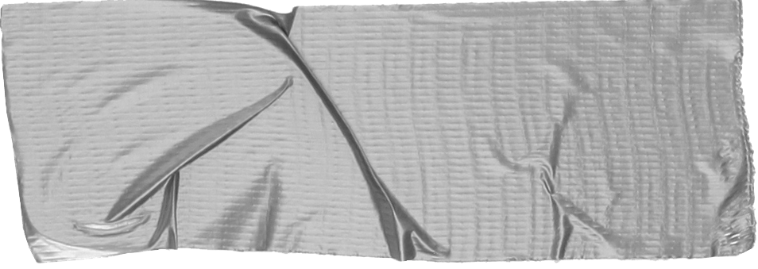

Upcoming events
Based on Meteo Rwanda forecast that 8-15/09/2025 and it will be shortened to
Launching of season 2026A at District level
Avenue: Kageyo sector, Mukore Cell on 18/09/2025
Launching of season 2026A at sector&cell level
Each sector & cell will determine date and sites where to be launching the seasons.

Slide 10
6. TAKE AWAY FOR 2026A
1. Ensure the adaptation of FoBaSi
Strengthening the mobilization of farmers
2. Intensify farmer training & extension
Use demo plots to showcase full agronomic packages.
3. Promote Climate-Smart Practices
Increase the agricultural productivity to better ensure food security
4. Banana rehabilitation
Banana maintenance and new suckers planned to be planted in partnership with ARCOS

Slide 11

“Our unity is our strength,
Our togetherness will bear fruit and provide food for all”
THANK YOU

