Slide 1
National Strategy for Transformation (NST2)

Slide 2
Recap of the National Development Planning Framework
The entire framework is linked and interdependent, to succeed all levels must implement accordingly
The Vision integrates international and regional commitments of Rwanda including AU Agenda 2063, EAC Vision 2050, SDGs, etc.
Vision 2050
National Strategy for Transformation 2
5YGP/NST 2 (2024 – 2029)
Sector Strategic Plans/SSPs
(covering Specific areas e.g. health, education )
District Development Strategies/ DDS
(considering District/CoK Specificities)
MTEF, Annual action plans, budgets, Imihigo, M&E

Slide 3
Integrated Framework for planning, M&E for NST2
NST2 Theory of change
NST 2 Theory of change
Goals/targets
SSPs Theory of change
Priority areas
Priority areas
DDSs Theory of change
Outcomes
Outcomes
NST 2 M&E Matrix
SSPs M&E matrix
Strategic interventions
Strategic interventions
DDSs M&E matrix

Slide 4
Lessons informing NST2 elaboration
  Achievement of NST1 was affected by a combination of shocks (Covid-19, Disasters and Inflation crisis) and implementation challenges
  NST2 builds on the lessons from the NST1 implementation and continues the drive towards Vision 2050
  NST2 needs to enhance the way of doing business
        Improve quality and scale
        Build resilience
        Integrate plans, programmes, projects & implement faster
        Enhance engagement of stakeholders e.g. private sector, CSOs, DPs, citizens, etc.

Slide 5
Macroeconomic requirements for NST2
9.3% average annual GDP growth
At least 6% for Agriculture
Over 10% for industry
Over 10% for services

Slide 6
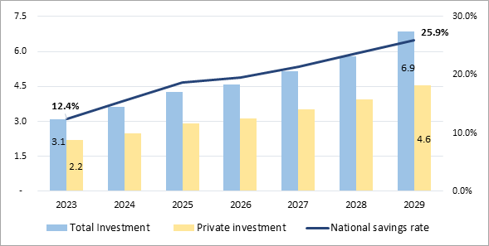
Macroeconomic requirements for NST2 cont’d
Increasing exports from USD 3.5 billion in 2023 to USD 7.3 billion in 2029 driven by tourism, mining, manufacturing, etc.
Increasing private investment from 2.2 Bn (15.9% of GDP) to 4.6Bn USD (21.5% of GDP)
More than doubling savings rate to 25.9%
Projections 2024-2029: Investment (in billion USD) – National Savings (in % of GDP)

Slide 7
NST2 high impact results
Building resilience to climate change and ensuring sustainable development
Boosting exports (to reduce the widening trade deficit)
Creating decent and productive jobs with a particular emphasis on youth and women ( to address high youth unemployment at 20.8%)
Improving the quality and market relevance of education (low enrolment in pre-primary education : 35% and low proficiency in key subjects, high unemployment among graduates)
Enhancing nutrition and early childhood development to reduce stunting (to reduce the high under-5 stunting rates: 33%)
Enhancing service delivery and citizen participation (Low quality of service delivery: 78%)

Slide 8

Economic Transformation

Slide 9


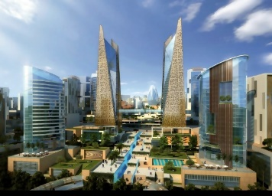

NST2 Economic Transformation priorities
Achieve over 6% annual Agriculture growth and ensure modernization of the sector
  Scale up access to modern inputs, technology and extension services
  Improving animal resources production through professional farming, improved breeds, extension services and feeds and raise milk production to meet industry demand i.e. Milk Powder Plant
  De-risking the sector through addressing value chain issues, post-harvest, insurance and scaling up financing
Achieve 10% annual growth in Industry (with focus on manufacturing) and double export revenues from $3.5 billion to $7.3 billion and increase tourism revenues by 80% to over $1Bn.
  Exports diversification and promotion of Made in Rwanda to reduce the trade deficit with focus on key industries
  Develop logistics and support standards for MSMEs to export
  Double private investment from $2.2 billion (15.9% of GDP) to $4.6 billion (21.5% of GDP)
Enhance connectivity, urbanization and settlements for growth
    Improving public transport services in urban and rural areas and promote e-mobility
    Expanding transport infrastructure (including marine transport) with focus on productive areas
    Complete Bugesera Airport and scale up RwandAir capacity (passengers and cargo)
    Develop affordable houses for rental and purchase in urban areas working with private sector
    Reduce informal settlements through upgrading and rehousing working with communities
Create 1.25 million (250k per year) productive and decent jobs
    Streamline support services (business development, advisory, finance, standards, etc.) to MSMEs
    Prioritizing job-intensive programs and projects across public and private sectors leveraging big projects
    Strengthening labor market systems to improve planning and matching job-seekers to jobs
    Creating a pool of talent for emerging sectors i.e. Financial services Center, Health, Engineering, Digital jobs, etc.

Slide 10




NST2 Economic Transformation priorities
Renewable energy transition and universal access to electricity for productive uses
    Ensure access to electricity in all cells of the country
    Increase electricity generation with focus on renewable energy
    Scale up adoption of clean and biomass efficient cooking solutions
    Develop nuclear technology for productive uses
Reduce greenhouse gas emissions by 38% and build resilience to climate change and disasters
    Complete the development Land Use masterplans and strengthen implementation of existing ones
    Mobilize climate finance for mitigation and adaptation initiatives across public and private sector
    Invest in disaster risk reduction, early warning systems and preparedness with focus on disaster prone areas
Accelerate digital transformation, digital skills and widescale adoption of technology across sectors
    Roll out of a Single Digital ID and target universal Digital literacy
    Develop digital skills through training 1 Million coders and 500k youth in advanced ICT Skills
    Foster adoption of digital and emerging technologies in public and private sector
Enhance financial sector services for private sector growth
    Continue positioning Kigali as a Financial services center and develop sub-sectors of Capital Market, Pension, Fintech, etc.
    Double domestic savings from 12.4% to above 25% and consolidate Umurenge SACCOs into a Cooperative Bank
    Diversify sources for financing for the Private sector i.e. Crowdfunding, Venture Capital, Blended finance, etc.

Slide 11
Social Transformation

Slide 12



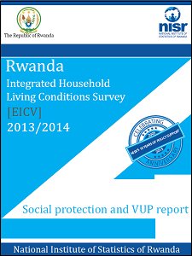
NST2 Social Transformation priorities
Improve quality of education at all levels
    Increasing Pre-primary net enrollment from 35% to 65%
    Improving quality in basic education through providing adequate learning materials, enhancing teachers capacity and school infrastructure.
    Equipping TVET and HLIs to enhance STEM learning and alignment to market demands
Enhanced quality of health, strengthened health systems, and reduced stunting
    Reduce the stunting rate for children under the age of five years from 33% to 15%
    Improving maternal, infant and child health to reduce related mortality
    Quadruple registered health workers to improve quality of healthcare
    Improve CBHI services
    Construct, rehabilitate and upgrade health facilities to provide high-quality health services
    Promote healthy lifestyles for disease prevention
Reduce poverty and enhance graduation
    Reducing poverty through empowering households to sustainably graduate from poverty with multi-sectoral approach
    Enhancing tracking and monitoring for effectiveness of social protection interventions
Scaled up access to clean water, sanitation, and hygiene (WASH)
    Accelerating universal access to WASH services for both productive use centers and to all villages countrywide
    Construction and operationalization of modern waste treatment plants and landfills in various districts
    Completion of central sewage system

Slide 13
Transformational Governance

Slide 14
NST2 Transformational Governance priorities
Ensuring rule of law
Reduce backlog cases in the justice system by half (from 62% to 30%)
Strengthening economic diplomacy to accelerate the country’s economic development
Enhancing service delivery, governance and implementation
Increase citizen’s satisfaction with public services delivery to above 90%
Public service reform for efficient delivery
Enhancing PFM to strengthen transparency and accountability
Strengthening National unity, resilience and community-based healing
Strengthening Public Finance Management, transparency and accountability
Sustaining and strengthening crime prevention, public order, safety and security

Slide 15
  NST2 implementation enablers
Optimizing Governance structures
Strengthening of cross-institutional platforms ( Ministerial Clusters, SWGs & JADF).
Improving Private Sector & CSOs, citizens, DPs, engagement
Improving project execution and delivery through streamlining the functioning of SPIUs across institutions
Strengthening integrated planning
Scaling up economic and spatial planning to ensure efficient allocation of resources
Strengthening automation of service delivery (Technology & digitaliization)
Data and statistics: Leveraging data to drive informed decisions
Strengthening Monitoring, Evaluation and Learning (MEL)
Harnessing data and Technology
Building Innovation and Skills
Strengthening Innovation, Research for development
Prioritizing capacity and skills development across all sectors

Slide 16
Critical success factors to build on
Visionary Leadership
Citizen centered good governance and accountability – engaging citizens, zero tolerance for corruption
Inclusive development model and leaving no one behind – gender equality, youth engagement, pro-poor plans, unity and solidarity, integration of PwDs, etc.
Home grown initiatives and innovations (e.g. Umuganda, Imihigo, IFMIS, e-procurement, etc).
Investment in human capital – education, health, capacity building in public and private sector
Results oriented institutional framework – effective performance management and ensuring delivery and implementation
Integrating ICT and innovation for enhanced service delivery, decision-making and productive use
Private Sector Participation – continuous engagement to accelerate their role
Sustaining Peace, Safety and security

Slide 17
Thank you!

