Slide 1
HEALTH INDICATORS IN NGORORERO DISTRICT
September 2024

Slide 2
Family planning

Slide 3
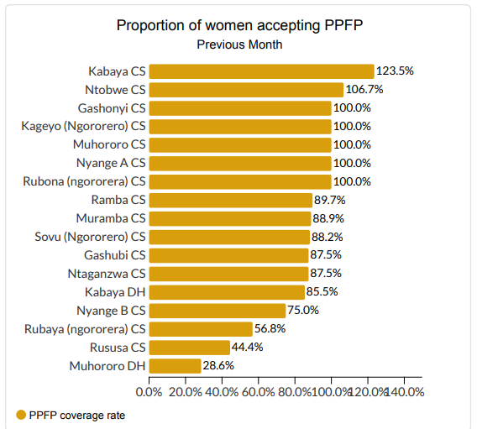
PPFP September 2024

Slide 4
4 Antenatal care visits (Target: 55%)

Slide 5
Vaccination Coverage

Slide 6
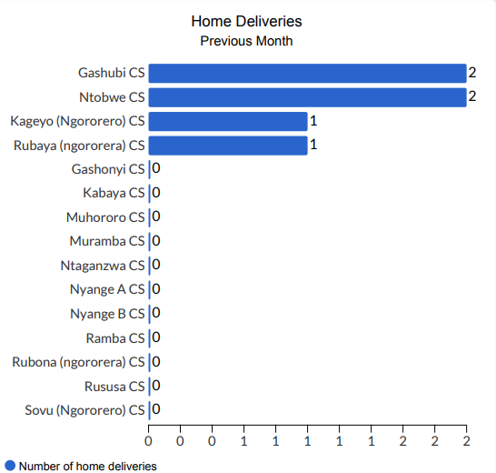
Home deliveries

Slide 7
NCDs up to Sept 2024

Slide 8
E-lmis usability

Slide 9
CBHI
No | Sector | Total Population | Other insurances | To be covered by Government | All pop with insurance | % Covered 100% | % covered 75%
1 | HINDIRO | 26,040 | 1,039 | 2,219 | 26679 | 102.3% | 102.5%
2 | MUHORORO | 22,273 | 602 | 2,147 | 22933 | 100.9% | 103.0%
3 | GATUMBA | 24,952 | 1,282 | 1,751 | 24946 | 95.7% | 100.0%
4 | BWIRA | 20,012 | 358 | 1,364 | 18925 | 91.4% | 94.6%
5 | MATYAZO | 27,673 | 705 | 1,966 | 25855 | 90.9% | 93.4%
6 | NDARO | 24,444 | 376 | 2,456 | 22902 | 90.5% | 93.7%
7 | NGORORERO | 38,823 | 2,165 | 2,850 | 35521 | 87.8% | 91.5%
8 | KABAYA | 36,324 | 1,807 | 3,009 | 33529 | 87.7% | 92.3%
9 | KAGEYO | 25,929 | 1,188 | 2,781 | 21684 | 80.0% | 83.6%
10 | NYANGE | 24,859 | 651 | 2,087 | 20005 | 77.0% | 80.5%
11 | KAVUMU | 32,791 | 655 | 3,095 | 26383 | 77.0% | 80.5%
12 | SOVU | 31,966 | 413 | 3,298 | 25538 | 74.9% | 79.9%
13 | MUHANDA | 31,869 | 658 | 2,848 | 24485 | 73.8% | 76.8%
 | Igiteranyo | 367,955 | 11,899 | 31,871 | 329385 | 86.2% | 89.5%

Slide 10
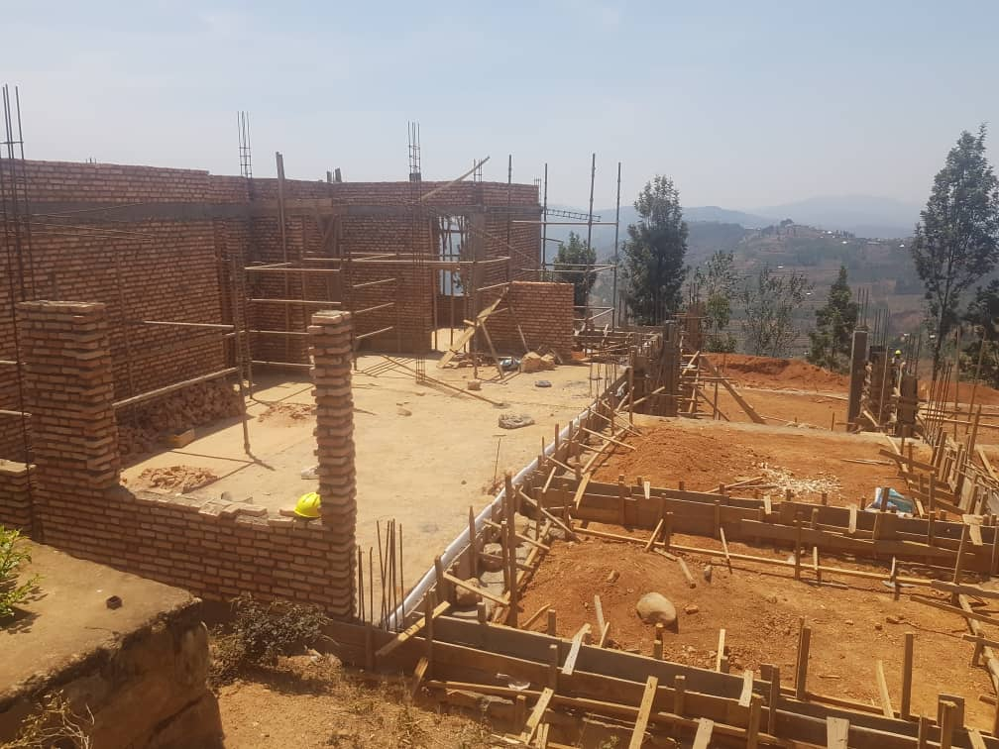
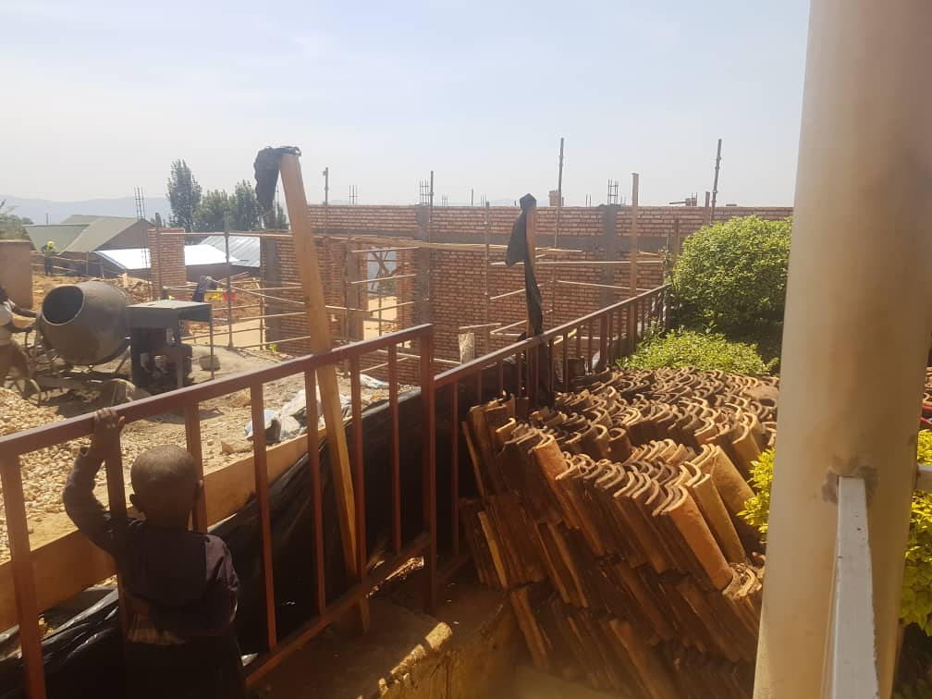
Current Health Sector Projects
Ntobwe Health Center

Slide 11
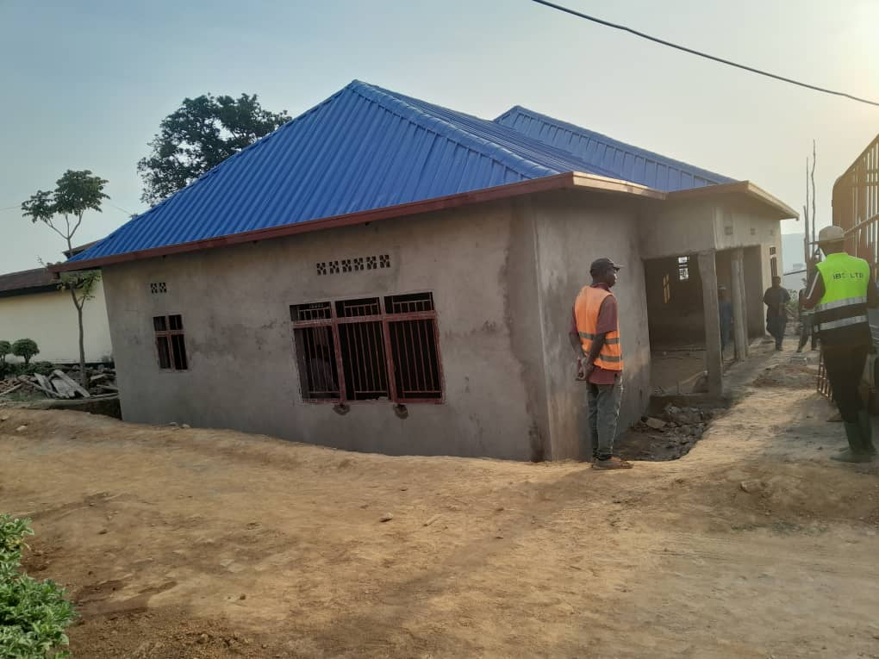
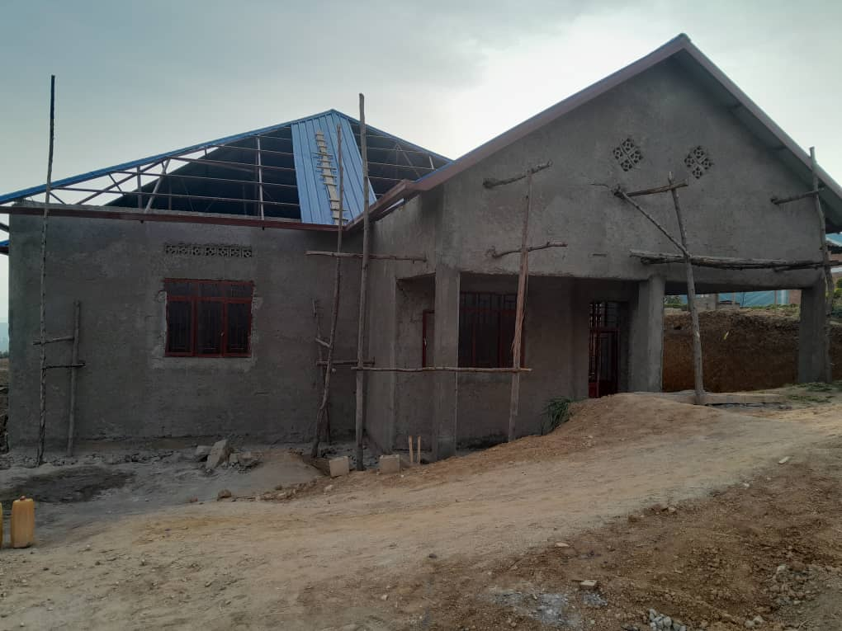
Nyange B Health Center

Slide 12
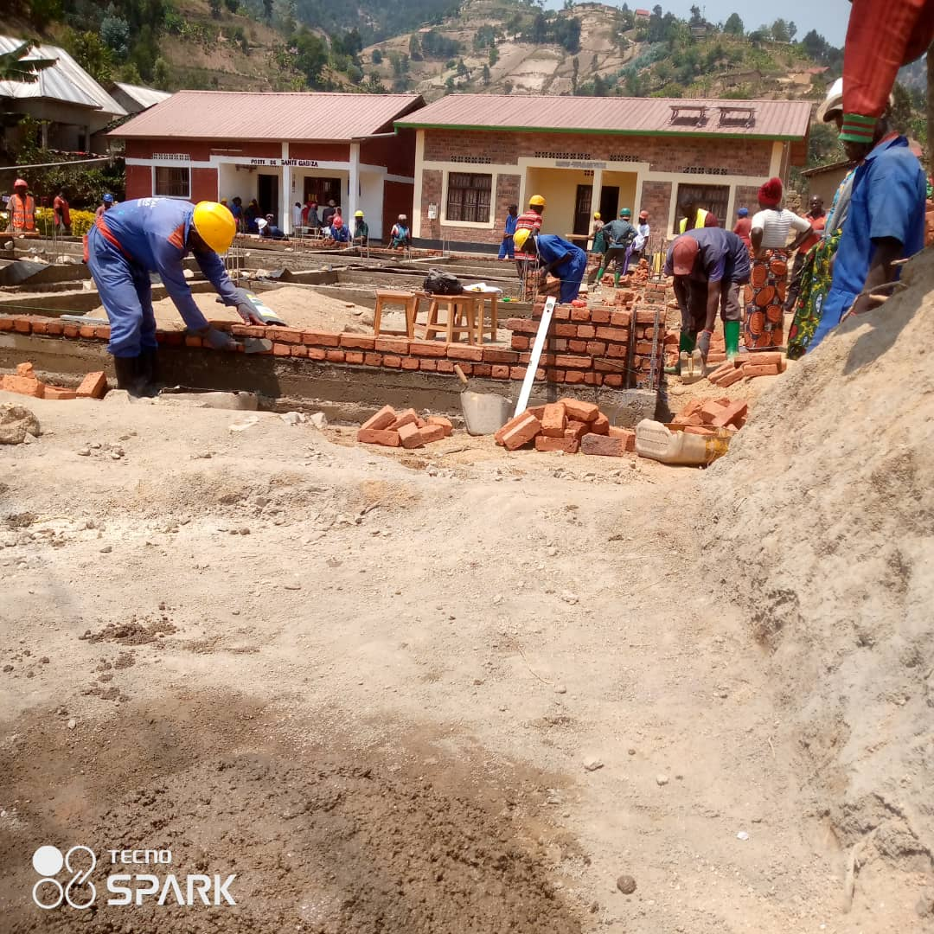
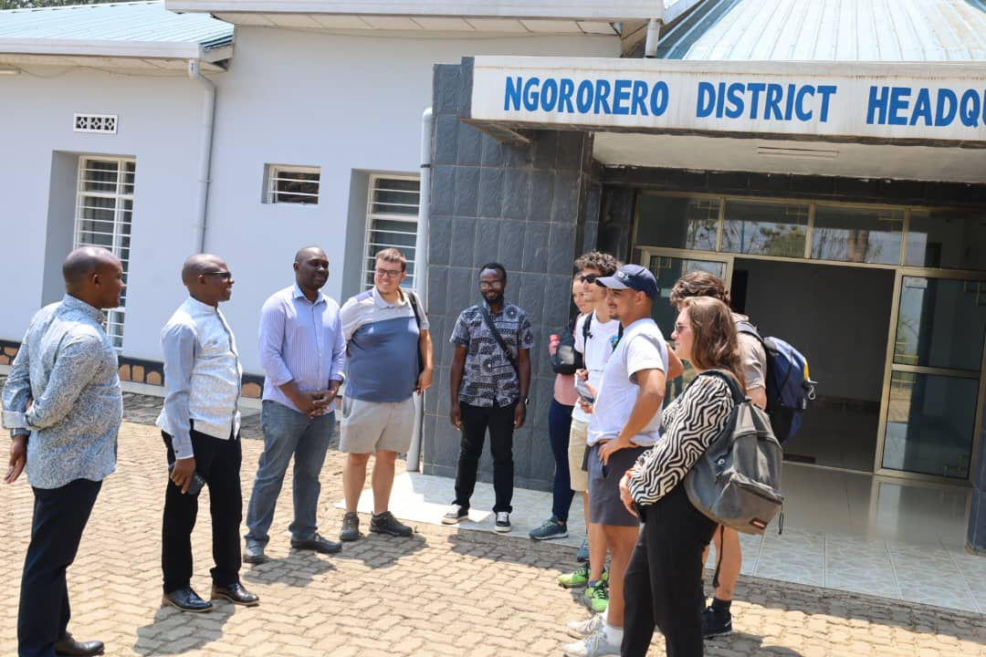
Gasiza Health Post (Maternity)

Slide 13
Projects under study
Kabaya HC
Muhororo HC

Slide 14
Some outcome indicators

Slide 15
Some outcome indicators

Slide 16
KABAYA DH
periodname | Total number of Maternal deaths | births live | Maternal mortality ratio per 100 000 births | Neonatal mortality rate (Per 1000 live births) | Under five mortality rate (per 1000 live birth) | Post C/Section infection | Deliveries by Caesarean Section | Post C/Section infection rate
September 2023 | 0 | 213 | 0 | 32.9 | 32.9 | 0 | 66 | 0%
October 2023 | 0 | 227 | 0 | 39.6 | 44.1 | 1 | 77 | 1%
November 2023 | 0 | 172 | 0 | 40.7 | 40.7 | 0 | 60 | 0%
December 2023 | 1 | 235 | 425.5 | 8.5 | 8.5 | 0 | 78 | 0%
January 2024 | 0 | 231 | 0 | 13 | 17.3 | 1 | 90 | 1%
February 2024 | 1 | 198 | 505.1 | 40.4 | 55.6 | 2 | 92 | 2%
March 2024 | 0 | 229 | 0 | 34.9 | 43.7 | 0 | 102 | 0%
April 2024 | 1 | 238 | 420.2 | 12.6 | 12.6 | 2 | 83 | 2%
May 2024 | 0 | 198 | 0 | 20.2 | 35.4 | 0 | 59 | 0%
June 2024 | 0 | 202 | 0 | 34.7 | 49.5 | 0 | 69 | 0%
July 2024 | 0 | 202 | 0 | 39.6 | 49.5 | 0 | 76 | 0%
August 2024 | 0 | 164 | 0 | 18.3 | 36.6 | 0 | 59 | 0%

Slide 17
THANKS

