Slide 1


REPUBULIKA Y’U RWANDA
INTARA Y’IBURENGERAZUBA
AKARERE KA NGORORERO
Ishusho y’uburezi kuwa13/05/2025
Biteguwe na:
HABARUREMA Denys
Umuyobozi w’Ishami ry’Uburezi

Slide 2
Ibigo by’amashuri
Ikiciro | Umubare
Amashuri y’incuke | 119
Amashuri abanza | 119
Amashuri yisumbuye | 52
Amashuri ya Tekiniki, imyuga n’ubumenyi ngiro | 15
Amashuri acumbikira abanyeshuri (boarding schools) | 14
Amashuri ya Leta | 38
Amashuri afashwa na Leta ku bw’amasezerano | 88
Amashuri yigenga | 10
Amashuri yose muri rusange | 136

Slide 3
Ibigo by’amashuri
Ikiciro | Umubare
Amashuri y’inshuke gusa | 0
Amashuri abanza gusa | 0
Amashuri y’inshuke ari kumwe n’abanza gusa | 77
Amashuri y’inshuke, abanza n’ayisumbuye,TVET Wing | 42
Amashuri yisumbuye gusa | 6
Amashuri yisumbuye +TVET Wing | 1
Amashuri ya TSS | 8
VTC gusa | 1
TTC | 1
Byose | 136

Slide 4
Abanyeshuri- 13/05/ 2025
Ikiciro | Abahungu | Abakobwa | Bose
Amashuri y’incuke | 8829 | 8942 | 17,771
Amashuri abanza | 39895 | 40308 | 80203
Amashuri yisumbuye | 7740 | 12335 | 20075
Amashuri ya tekiniki, imyuga n’ubumenyingiro | 1677 | 1220 | 2897
Bose | 58141 | 62805 | 120946

Slide 5
Abarimu bahari
Ikiciro | Abagabo | Abagore | Bose
Amashuri y’incuke | 48 | 257 | 305
Amashuri abanza | 941 | 1138 | 2079
Amashuri yisumbuye | 547 | 330 | 877
Amashuri ya tekiniki, imyuga n’ubumenyingiro | 164 | 74 | 238
Bose | 1700 | 1779 | 3499

Slide 6
IBYUMBA BY’AMASHURI BIHARI
IKICIRO | UMUBARE W’IBYUMBA
AMASHURI Y’INSHUKE | 281
AMASHURI ABANZA | 1446
AMASHURI YISUMBUYE | 538
AMASHURI YA TEKINIKI,IMYUGA N’UBUMENYINGIRO | 123
YOSE | 2386

Slide 7
Ibyumba bishya bikenewe
IKICIRO | UMUBARE W’IBYUMBA
Kugabanya ubucucike (ibigo 107/136) | 635
Kuvanaho double shift (ibigo 81/119) | 440
Gusimbuza ibyumba bishaje | 269
Byose | 1344

Slide 8
Ubwiherero
Ubwiherero buhari bukoreshwa: 3,628
Ubwiherero bushaje bukwiye gusenywa bugasimbuzwa ubushya: 702
Ubwiherero bushya bukenewe kwiyongera ku buhari: 1772

Slide 9
Intebe (desks)zihari
IKICIRO | UMUBARE W’INTEBE
AMASHURI Y’INSHUKE | 5707
AMASHURI ABANZA | 36647
AMASHURI YISUMBUYE | 11665
AMASHURI YA TEKINIKI,IMYUGA N’UBUMENYINGIRO | 2814
YOSE | 56833

Slide 10
Intebe nshya zikenewe
IKICIRO | UMUBARE W’INTEBE
AMASHURI Y’INSHUKE | 4,866
AMASHURI ABANZA | 4,423
AMASHURI YISUMBUYE | 2,252
AMASHURI YA TEKINIKI,IMYUGA N’UBUMENYINGIRO | 320
YOSE | 11,861

Slide 11
AMAZI N’AMASHANYARAZI
Ibigo bifite amazi ku ishuri: 112/136= 82.35%
Ibigo bidafite amazi ku ishuri: 24/136=17.64%
Ibigo bifite amashanyarazi:109/136=80.15%
Ibigo bidafite amashanyarazi: 27/136=19.85%

Slide 12
Ibibazo biri mu burezi muri rusange
No | Ikibazo | Icyakozwe | Igikenewe
1 | Ibyumba by’amashuri bishaje cyane bikeneye gusenywa bigasimbuzwa ibishya n'ibyumba bikeneye kuvugururwa | Kubarura ibyo byumba | Kubaka ibyumba by’amashuri 269 bishya bisimbura ibishaje no kuvugurura ibyumba 519
2 | Ubucucike mu mashuri | Kugaragaza ibyumba by'amashuri bikenewe kugira ngo ubwo bucucike bugabanuke | Hakenewe kubakwa ibyumba bishya 635
3 | Gahunda yo kwiga mu buryo bwa Single shift itari hose mu bigo by'amashuri | Kubarura ibyumba by'amashuri bikenewe kugura ngo iyo gahunda ishyirwe mu bikorwa hose | Hakenewe ibyumba bishya 440 kugira ngo double shift iveho

Slide 13
Ibibazo biri mu burezi
NO | IKIBAZO | ICYAGIKOZWEHO | IGIKENEWE
4 | Abarimu n’abakozi bo mu buyobozi bw’amashuri batari baboneka | Gusaba abo bakozi muri REB na RTB | Kubona abo barimu n’abakozi 145 kugira ngo bunganire abahari
5 | Umubare munini w'abarimu batize uburezi | kubarura abatarize uburezi bigisha mu mashuri y’inshuke n’abanza (855) | Guhugura abo barimu ku buryo bwo kwigisha ( amasomo yaratangiye azatangwa mu byiciro bibiri
6 | Ibigo bya 9&12ybe bitagira laboratories | Kumenya ibigo bidafite laboratories | Kubakirwa sciences laboratories haherewe ku bigo 10 bifite amashimi y’ubumenyi
7 | Imirenge idafite TVET Schools | Kugaragariza RTB ahakenewe gushyirwa TVET wing | Gushyira TVET Wings mu Mirenge zitarimo ( Gatumba, Muhororo,Ngororero,Kabaya)

Slide 14
Ibibazo biri mu burezi
NO | IKIBAZO | ICYAGIKOZWEHO | IGIKENEWE
8 | Ibigo by'amashuri bitagira mudasobwa ( OLPC& Laptops za smart classrooms | Kubarura ibigo bidafite OLPC (54) na smart classroom (33) Gusaba REB gutanga smart classrooms na OLPC | Guha ibigo by'amashuri abanza OLPC na smart classrooms mu mashuri yisumbuye
9 | Ibigo by’amashuri bifatite amazi n’amashanyarazi | Kubarura ibyo bigo no kubishyira muri gahunda y’ibizagezwaho amazi n’amashyanyarazi | Kugeza amazi ku bigo 24 n’amashanyarazi ku bigo 27
10 | Ibigo by’amashuri bifite ibikoni bishaje | Kubarura ibyo bigo no kubimenyesha Mineduc | Gukora ubuvugizi ibyo bigo 4 bikubakirwa ibikoni ( GS kamashi, GS Kinanira, GS Ruhunga c, ES Kavumu), GS Rususa kigiye kubakwa
11 | Ibigo bitagerwaho imihanda, n’ibiraro byatwawe n’ibiza | Kumenya ibigo bitagerwaho imihanda | Kugeza imihanda ku bigo 10
12 | Ubushobozi buke bw’amashuri butuma bigira imyenda bitabasha kwishyura |  | Kongera amafaranga ya capitation grant na school feeding ibigo bigenerwa

Slide 15
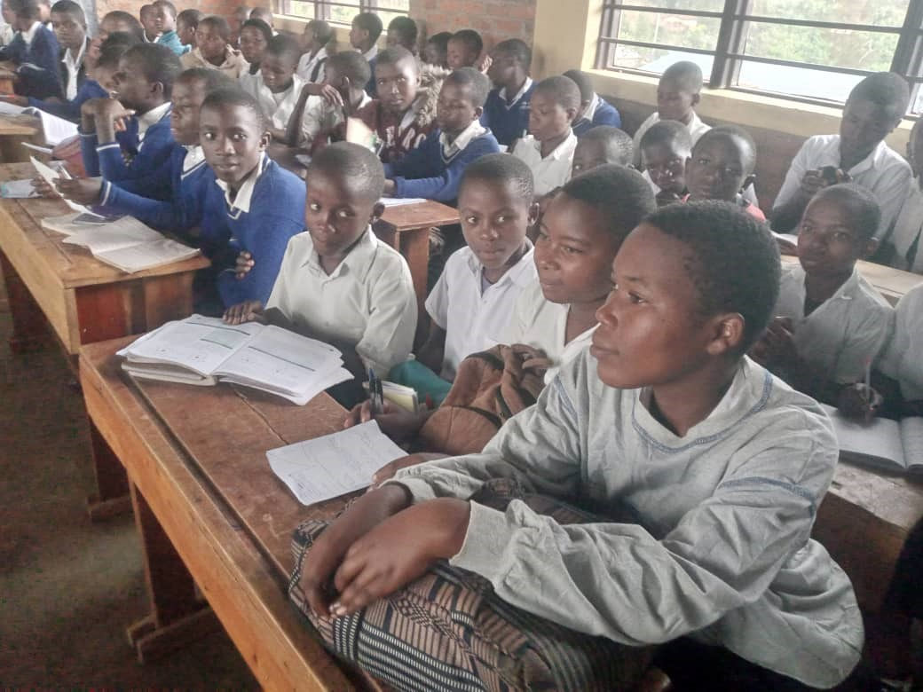
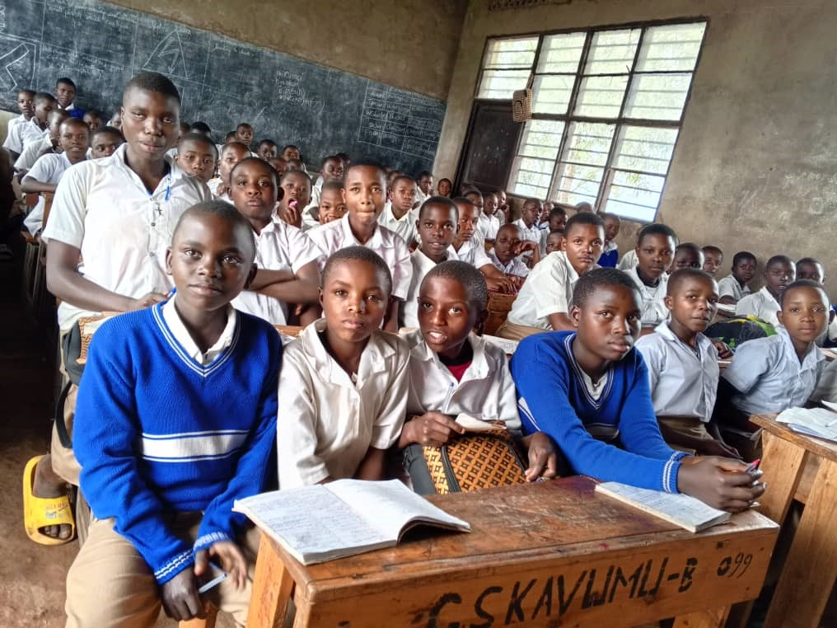
Amafoto agaragaza ubucucike
GS KANOGO/MUHORORO Sector
GS KAVUMU B/MATYAZO Sector

Slide 16
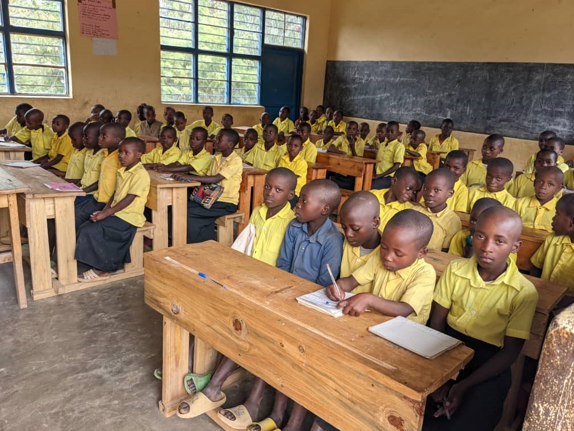
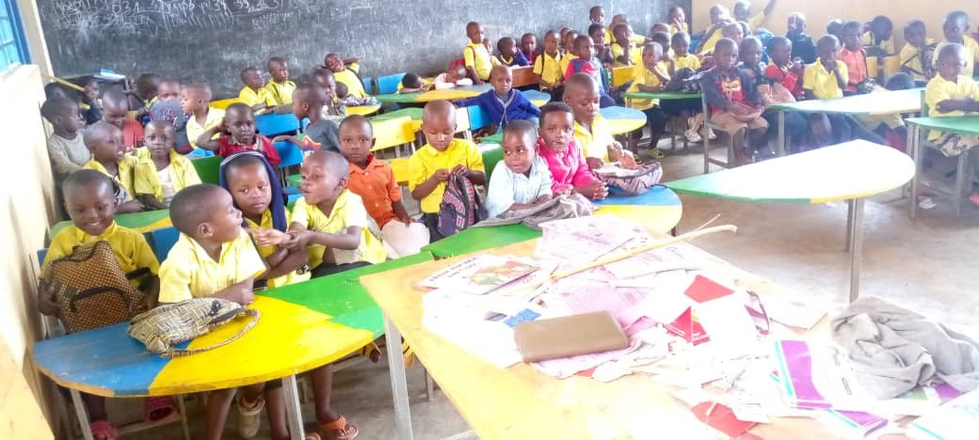
CS KUNTURO/MATYAZO SectorS KUNTURO/MATYAZO Sector
CS KAZABE/NGORORERO Sector

Slide 17
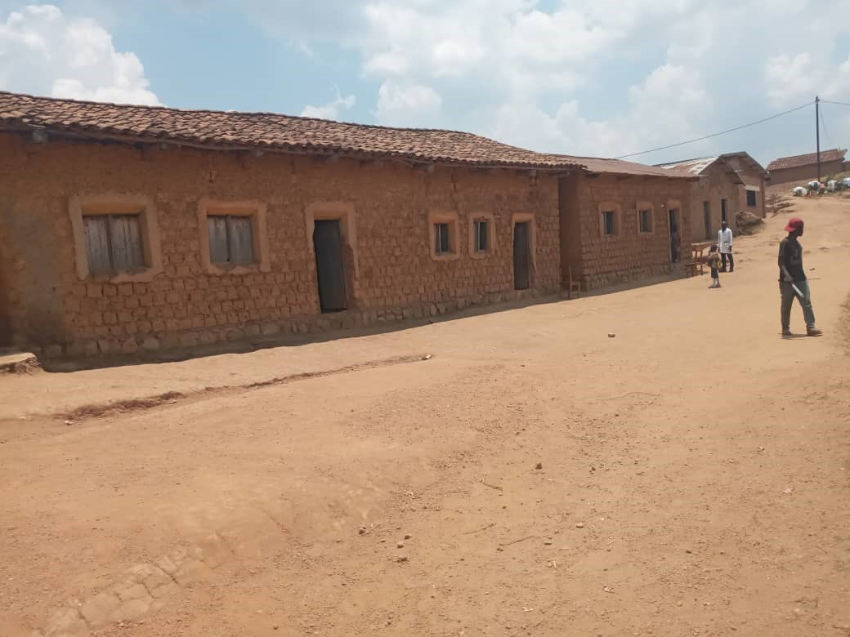
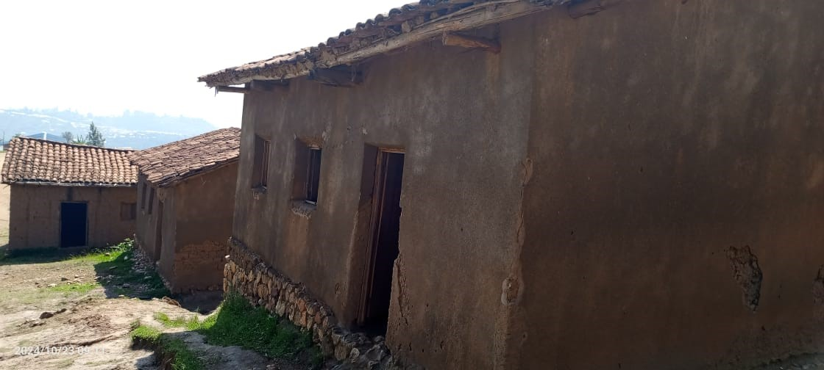
Ibyumba bikeneye gusimbuzwa
CS MUTAKE/ Kavumu Sector
GS RURIMBA/ Kageyo Sector

Slide 18


